Slide 1
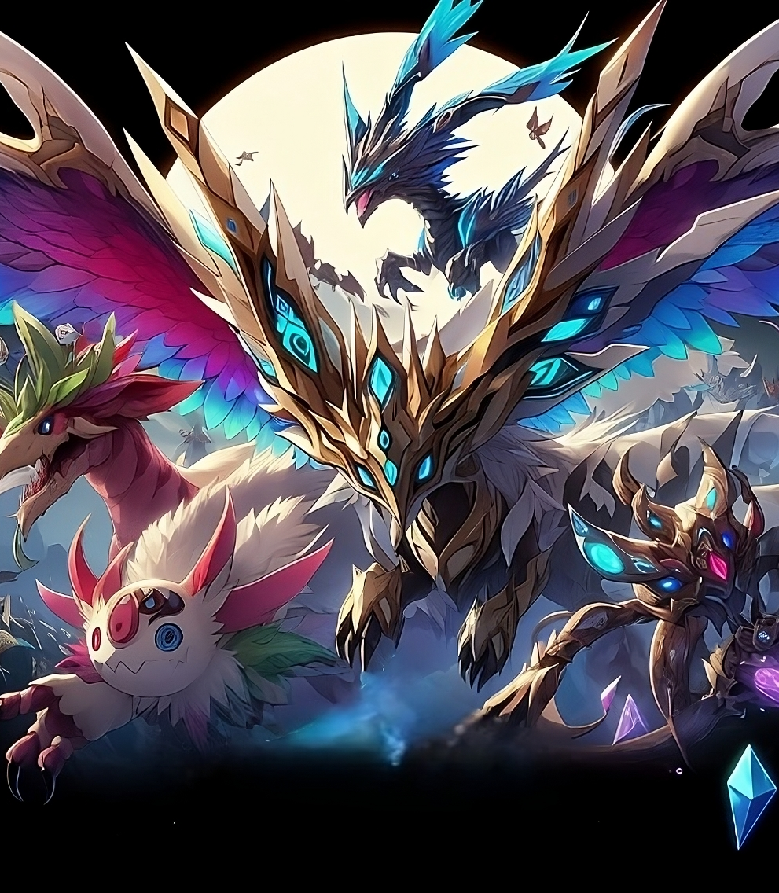


BDLTs project
Group: CryptoFolks
Prof: Claudio Di Ciccio

Slide 2

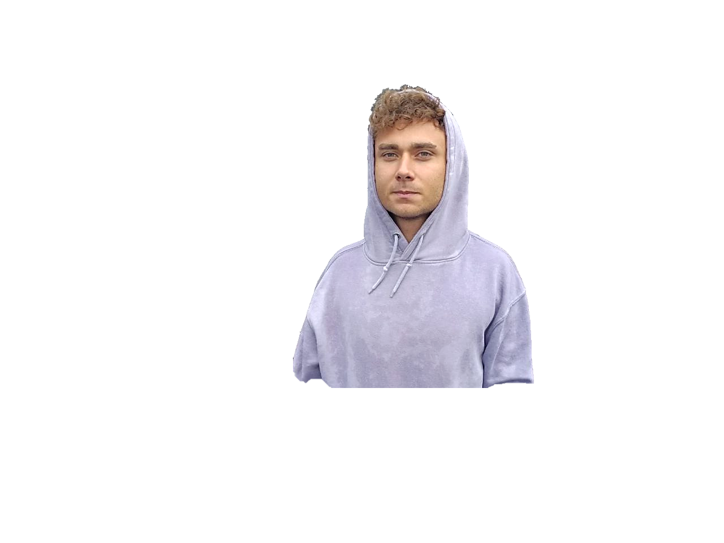

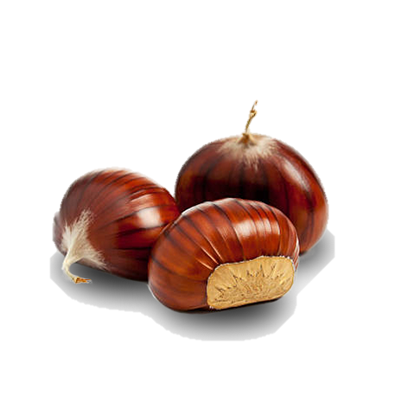
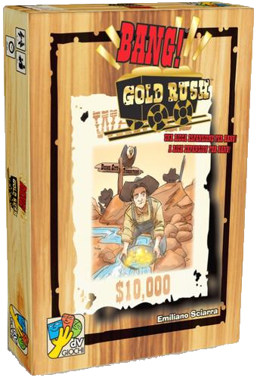
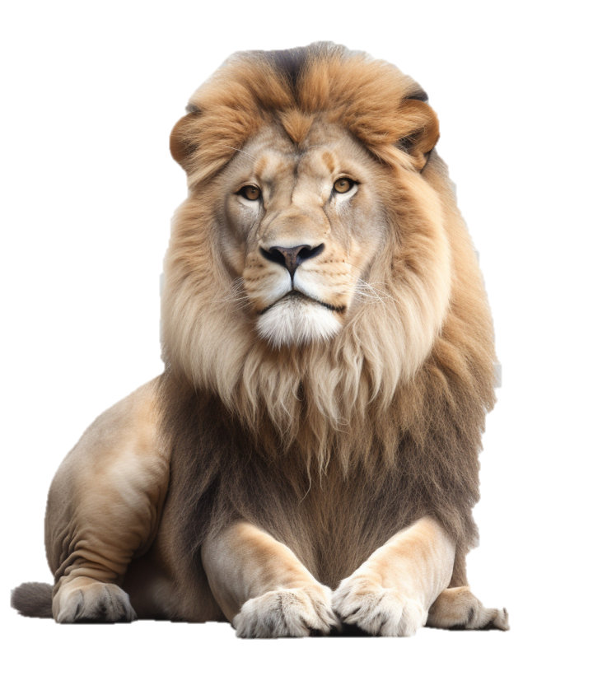



Team
Inventory
Nicolò Dentale
Abilities
1868948
Artwork and creativity.
The lion survivor, from Ladispoli.
Creativity
Back-end
AI

Slide 3
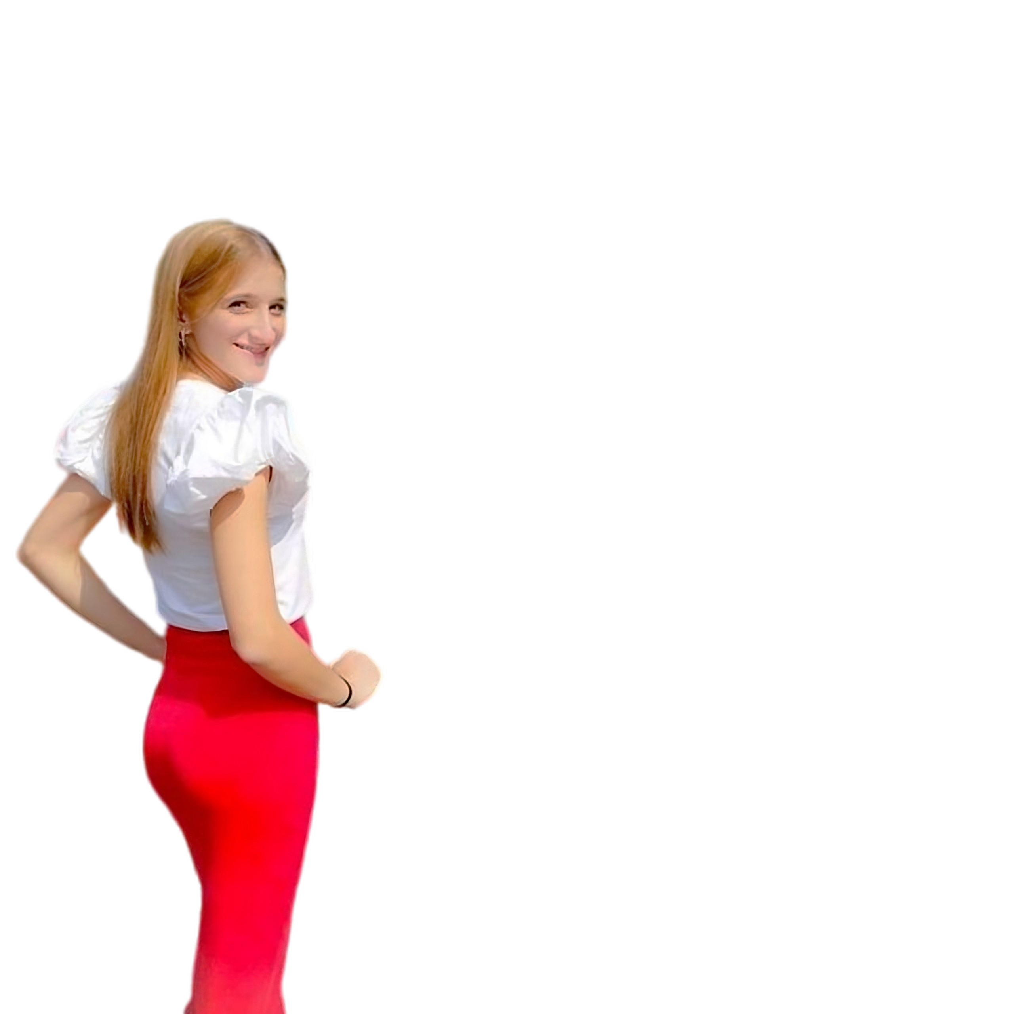

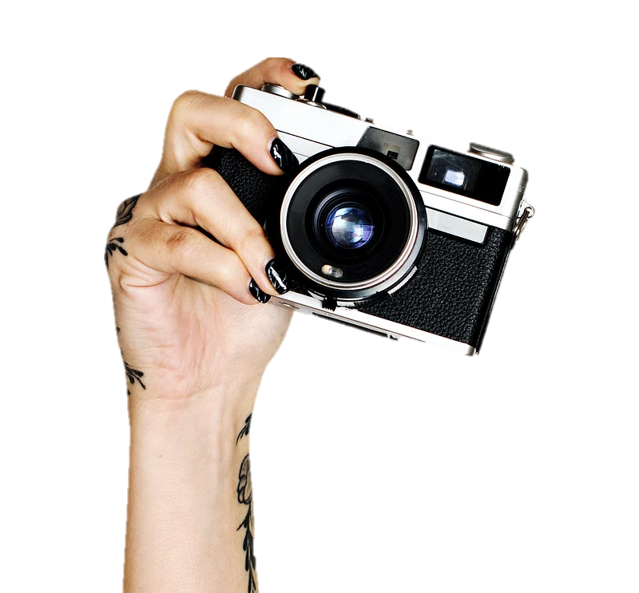





Team
Inventory
Carmelina De Lauso
Abilities
2071848
Study is my passion,
however, sleep is better
Front-end
Design
UML

Slide 4
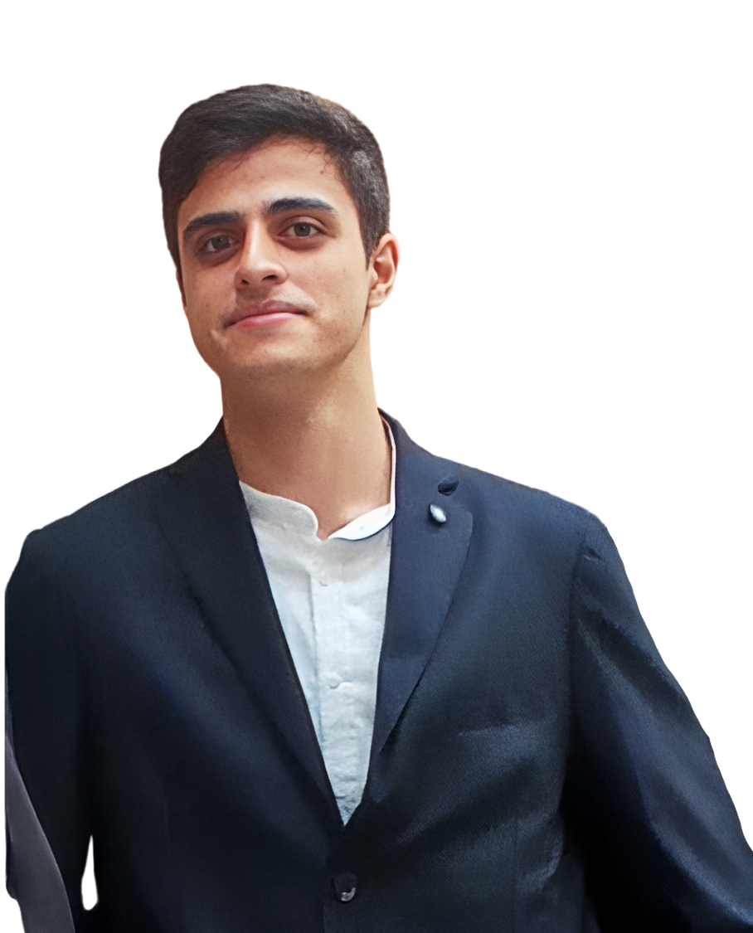

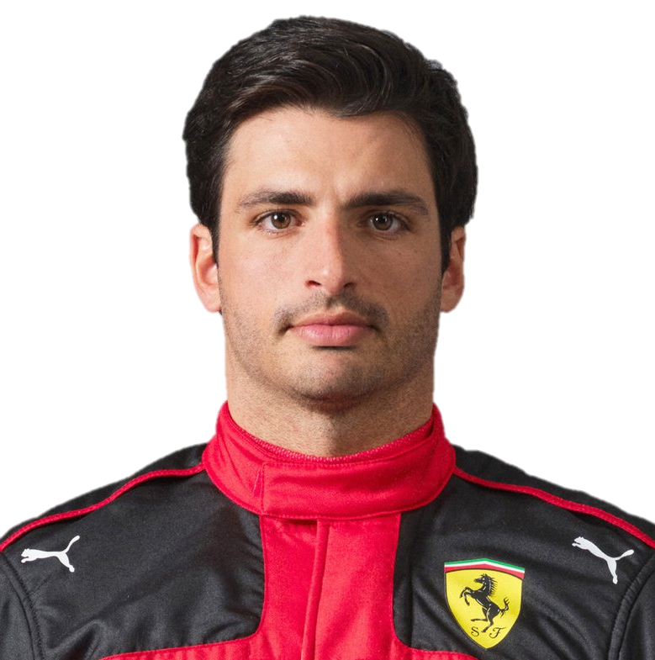

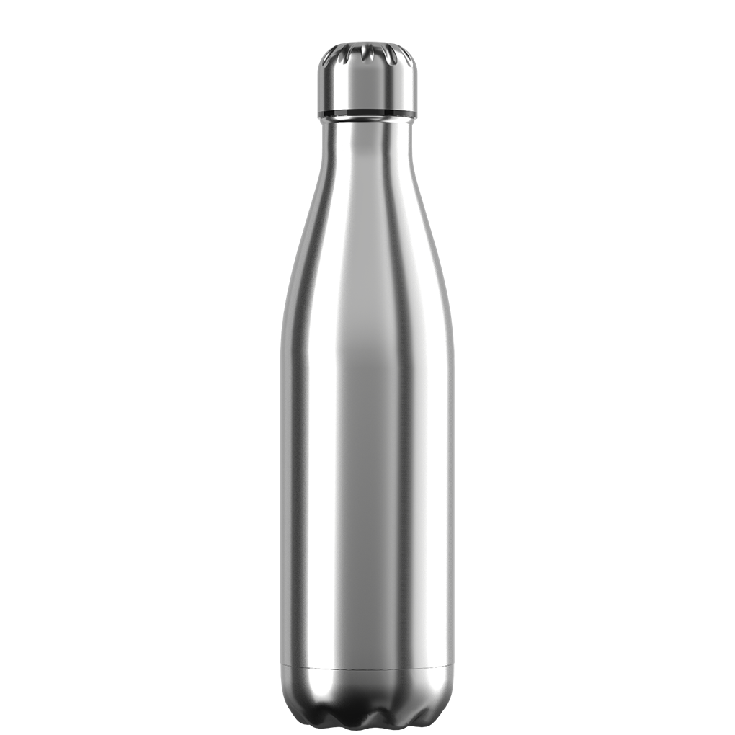


Team
Inventory
Mattia Russo
Abilities
1918968
The mind and the arm,
smooth operator
Back-end
Solidity
UML

Slide 5
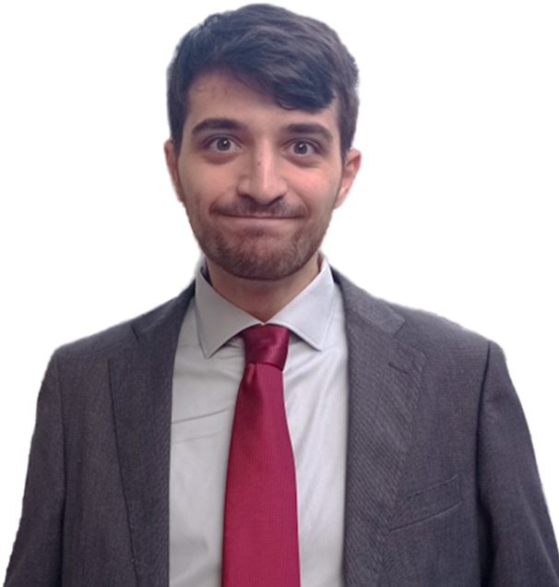
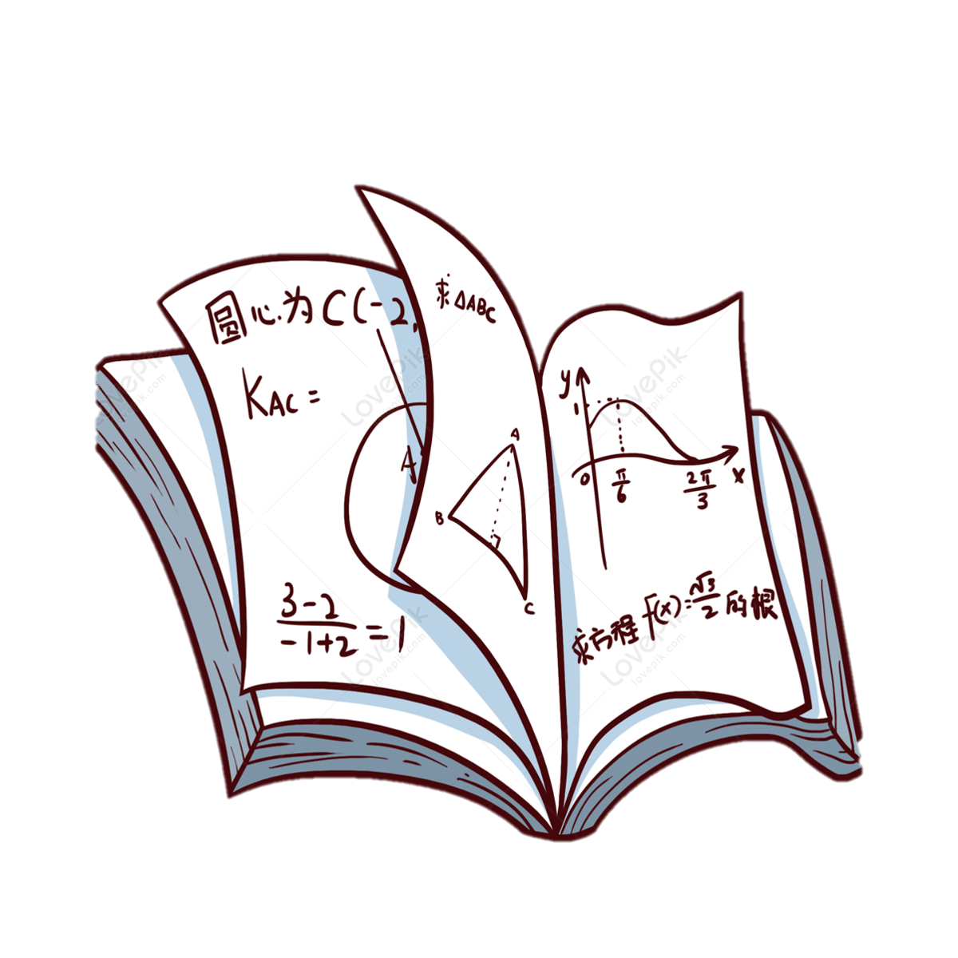



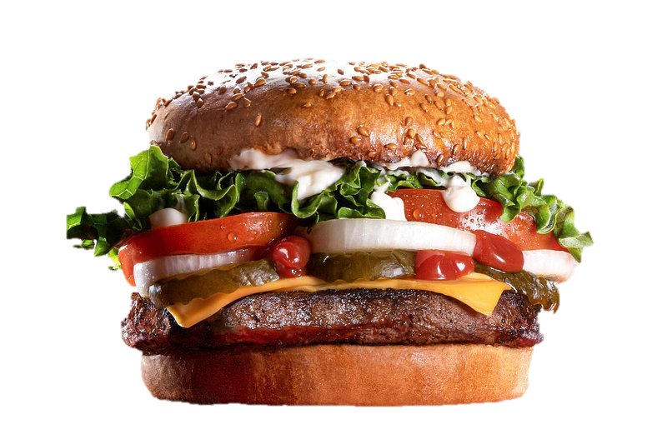

Team
Inventory
Claudio Schiavella
Abilities
1884561
Commitment, passion, stakanovism and lots of anxiety.
PowerPoint
Solidity
AI

Slide 6
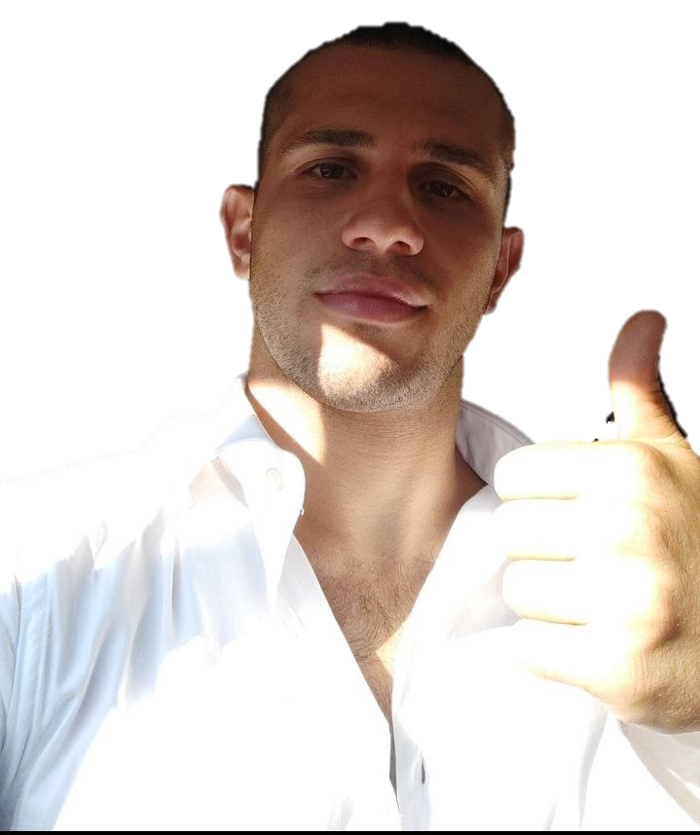


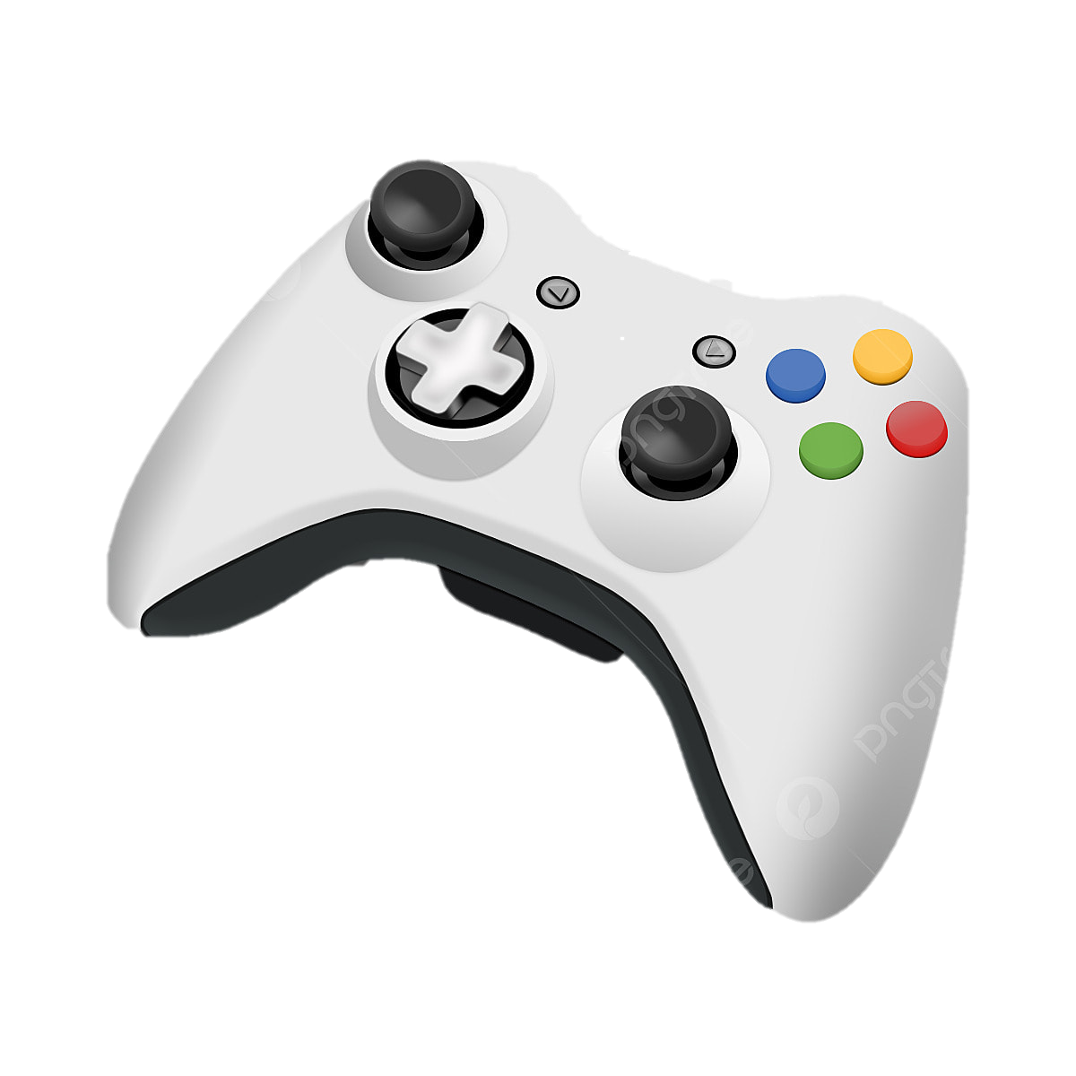

Team
Inventory
Nicholas Urbanelli
Abilities
2078401
The studio is a gray apostrophe between sea and vacation.
Back-end
Solidity
Design

Slide 7
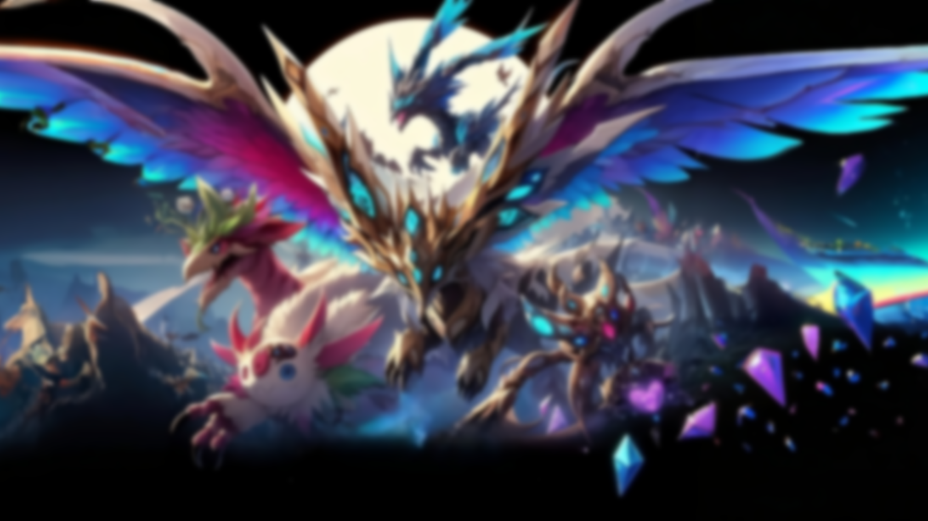
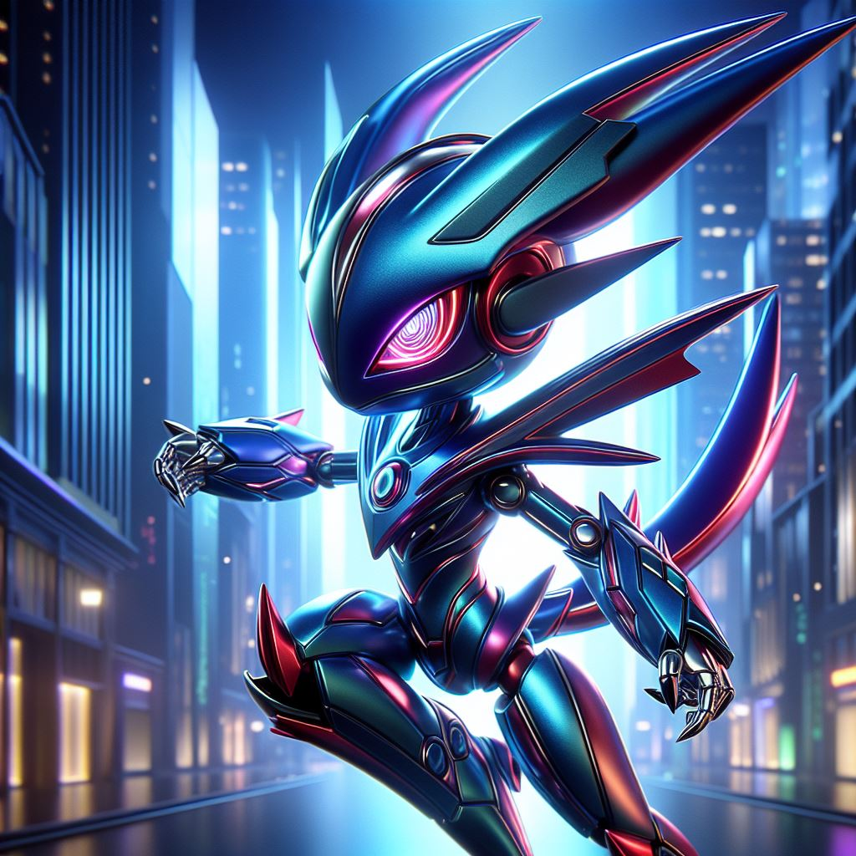
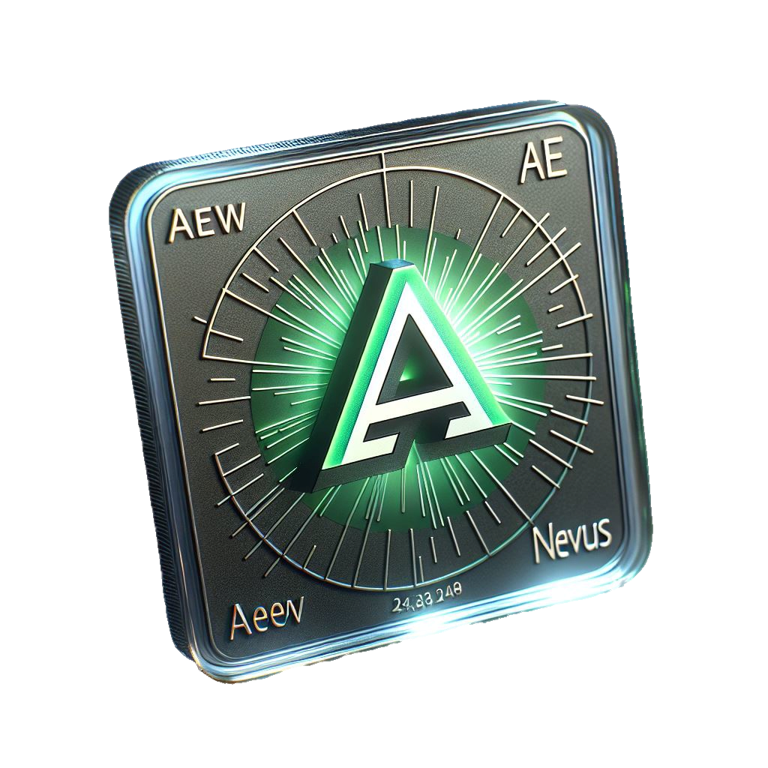
Goal: Making a game of AI-generated collectibles
Trading and tasks
Market with fungible token

Slide 8
Goal: Making a game of AI-generated collectibles
YES
Store state
?
It is necessary to know the owner of each collectible and avoid duplication
Trading and tasks
Market with fungible token
Multiple
writers
?

Slide 9
Store state
?
YES
Multiple
writers
?
More people can interact with the Dapp
Use TTP
?

Slide 10
Multiple
writers
?
NO
Use TTP
?
Has anyone ever had a figurine manager?
Known writers?

Slide 11
Use TTP
?
NO
Known writers?
It would be nice to meet everyone who is passionate about our project, but we are shy.

Slide 12
Multiple
writers
?
Website
Known writers?
Store state
?
Permissionless Blockchain
Use TTP
?
Decentralized
Public
No cheating

Slide 13
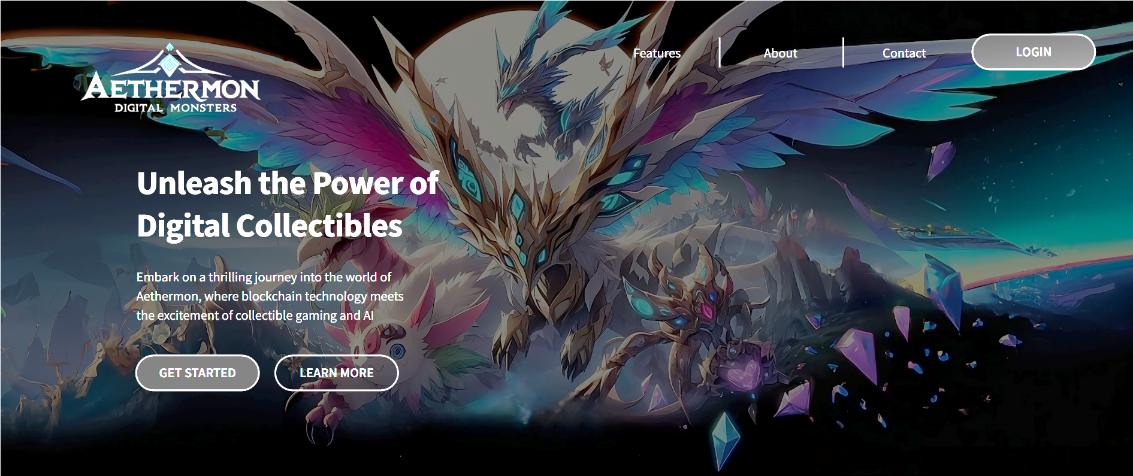
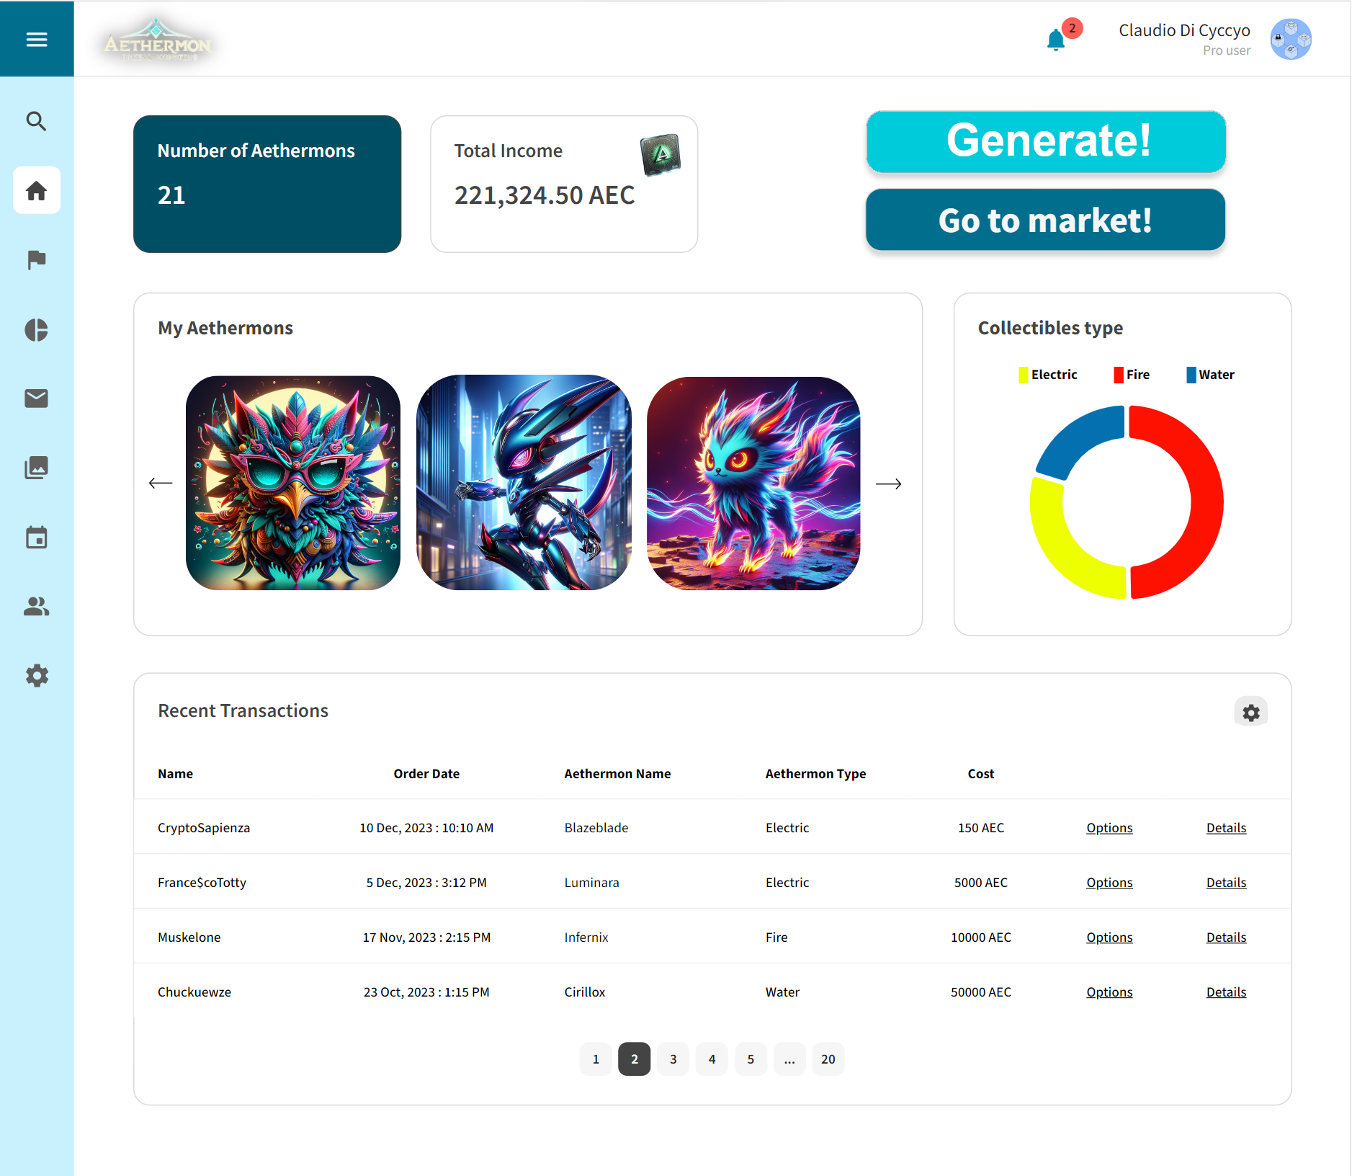
Website
Permissionless Blockchain
Decentralized
Efficiency
No cheating

Slide 14
Website

Slide 15

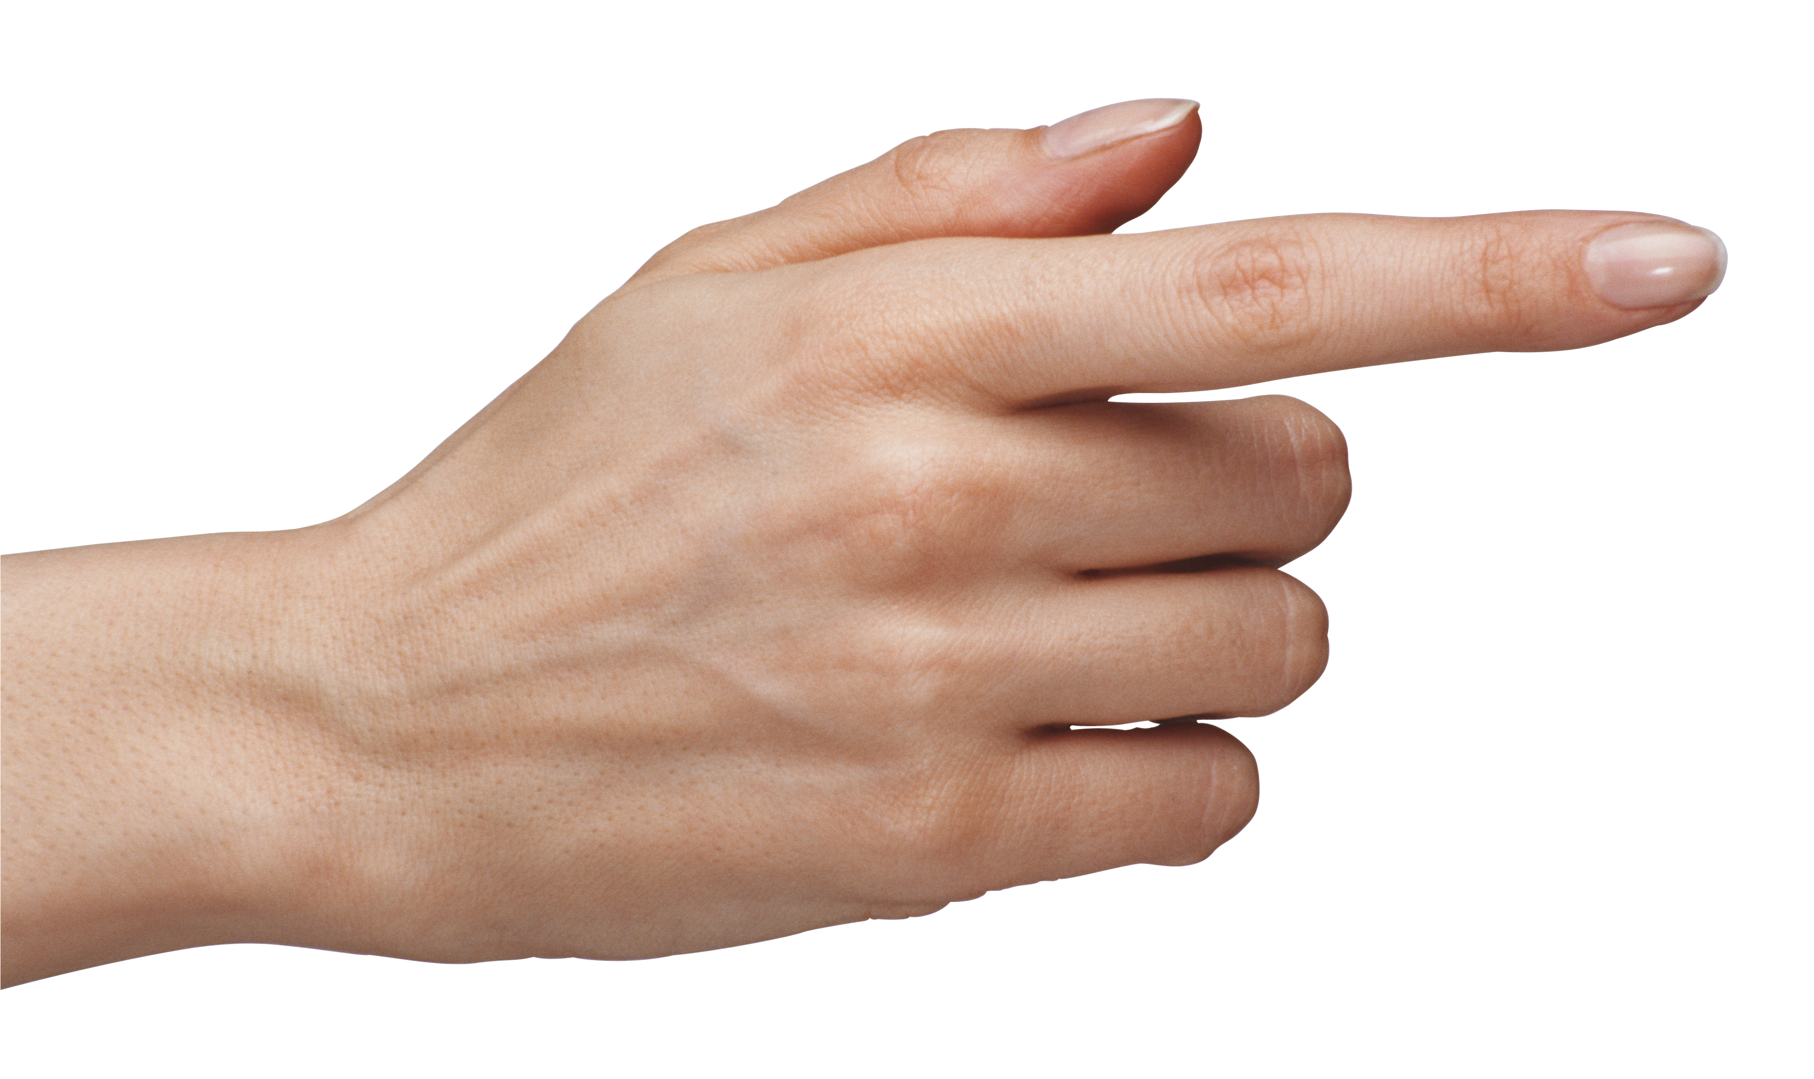

Website
Demo – Image generation
Demo – Trading
Coin.sol
AI generation
Generate!
Create.sol
Notes:
Approccio simile per il market + Interfacciamento WEB3 implicito

Slide 16

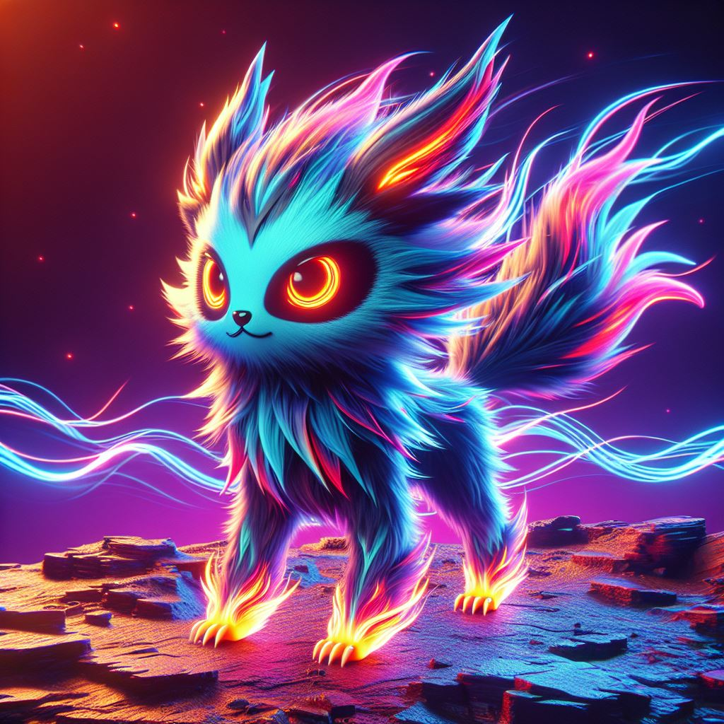
Demo – Trading
Trade.sol

Slide 17
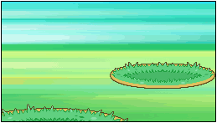



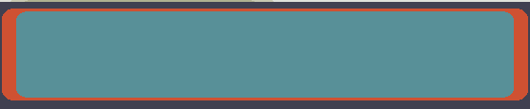
Demo – Task
ATK
DEF
Task.sol

Slide 18

Demo – Task
Possible issues
AI model management
Pseudorandomicity
Market & tasks complexity
ATK
DEF
Task.sol

Slide 19
THANK YOU FOR THE ATTENTION!
Gotta block’em all
Vote for us!
(we have candies and kitties)

